Slide 1
Design and Analysis of Algorithms (CS345A)
Lecture 27
Maximum Flow
Proof of Lemma from last Lecture
Applications
Generalization

Slide 2
Recap of the last lecture

Slide 3
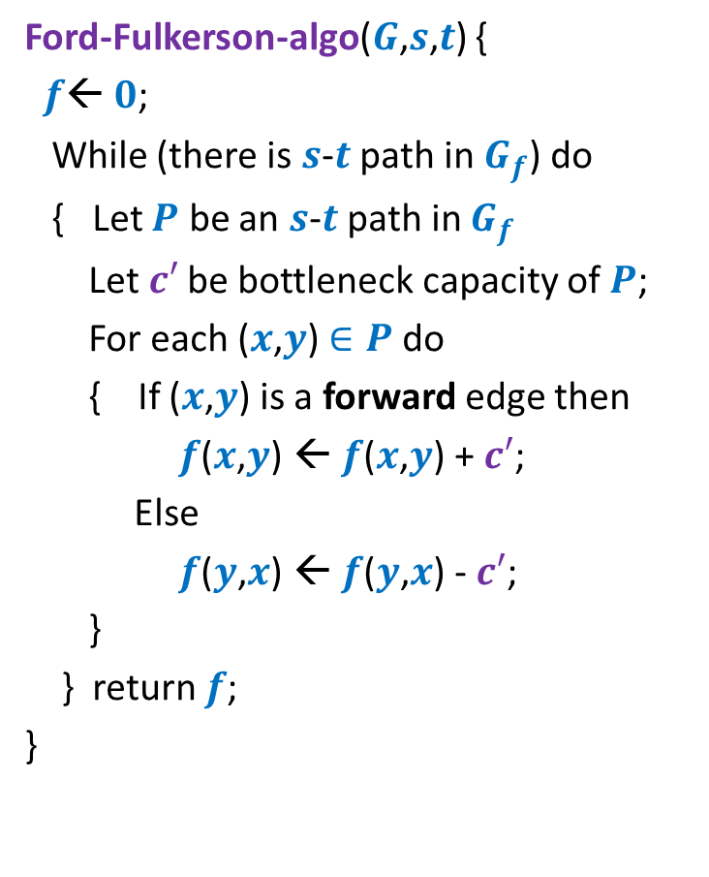


Algorithm 2
Ford-Fulkerson-algo($G$,$s$,$t$) {
$f$← $0$;
While (there is $s$-$t$ path in $G_{f}$) do
{ Let $P$ be an $s$-$t$ path in $G_{f}$
Let$c′$ be bottleneck capacity of $P$;
For each ($x$,$y$) $∈P$ do
{ If ($x$,$y$) is a forward edge then
$f$($x$,$y$) ← $f$($x$,$y$) + $c′$;
Else
$f$($y$,$x$) ← $f$($y$,$x$) - $c′$;
}
} return $f$;
}
Algorithm-2($G$,$s$,$t$) {
Let $P$ be the shortest $s$-$t$ path in $G_{f}$;

Slide 4









A crucial Insight
Lemma : Distance from $s$ to each vertex increases monotonically in $G_{f}$.
$$δ_{f′}\left(s,x\right)≥δ_{f}\left(s,x\right)$$
$$δ_{f}(s,x)$$
$$s$$
$$t$$
$$x$$
$$G_{f}$$
After $i$th Iteration
$$δ_{f′}(s,x)$$
$$s$$
$$t$$
$$G_{f′}$$
$$x$$
Was given as a Homework

Slide 5





Proof by contradiction
$δ_{f′}\left(s,x\right)<δ_{f}\left(s,x\right)$
Let $x$be the nearest “defaulter”.
➔ For each vertex $v$in $G_{f′}$ with $δ_{f^{′}}\left(s,v\right)<δ_{f′}(s,x)$,
$δ_{f}\left(s,v\right)≤δ_{f′}\left(s,v\right)$
$$δ_{f}(s,x)$$
$$s$$
$$t$$
$$G_{f}$$
$$x$$
$i$th Iteration
$$δ_{f′}(s,x)$$
$$G_{f′}$$
$$s$$
$$t$$
$$x$$

Slide 6








Proof by contradiction
Definitely $δ_{f}\left(s,u\right)≤δ_{f′}\left(s,u\right)$
➔ edge $\left(u,x\right)$ must have appeared in residual network after $i$th iteration.
➔Edge $\left(x,u\right)∈P$ (the path selected during $i$th Iteration)
➔ $δ_{f}\left(s,u\right)=δ_{f}\left(s,x\right)+1$
$$δ_{f}(s,x)$$
$$P$$
$$s$$
$$t$$
$$G_{f}$$
$$x$$
$$u$$
$$u$$
$i$th Iteration
?
$$G_{f′}$$
$$s$$
$$t$$
$$u$$
$$x$$
contradiction
$>δ_{f′}\left(s,x\right)+1$
$=(δ_{f^{′}}\left(s,u\right)+1)+1$
$δ_{f}\left(s,u\right)>δ_{f′}\left(s,u\right)$

Slide 7
Application of Max-Flow
Bipartite Matching

Slide 8
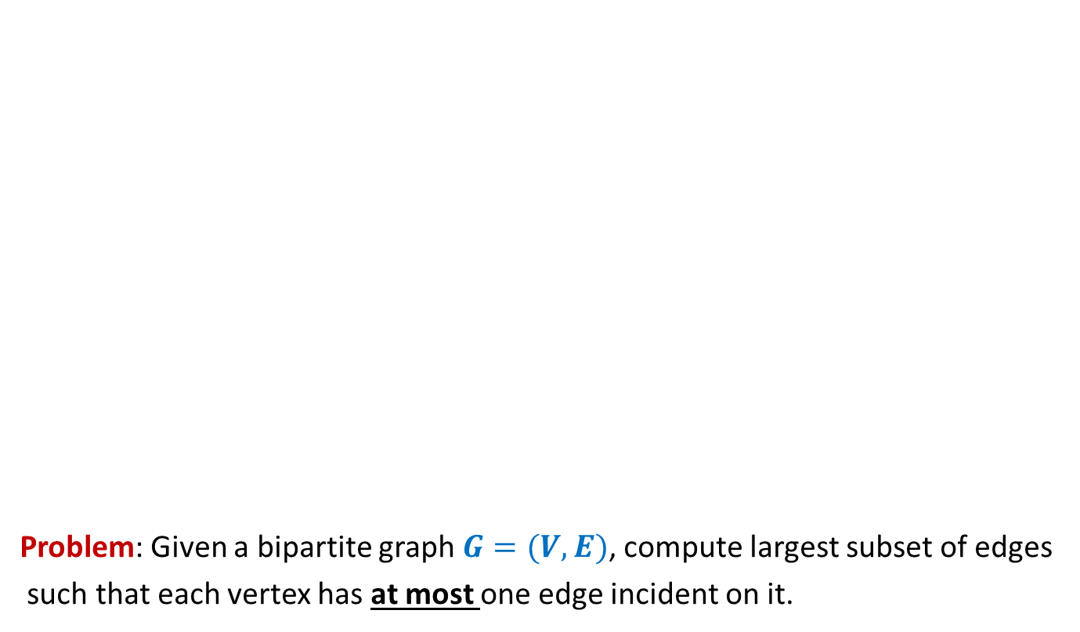
Bipartite matching
Problem: Given a bipartite graph $G=(V,E)$, compute largest subset of edges
such that each vertex has at most one edge incident on it.
applicants
jobs
Matching of size 5
Matching of size 3

Slide 9







Bipartite matching Maximum Flow
applicants
jobs
$$1$$
$$1$$
$$1$$
$$1$$
$$1$$
$$1$$
$$1$$
$$1$$
$$G′$$
$$s$$
$$1$$
$$t$$
$$1$$
$$1$$
$$1$$
$$1$$
$$1$$
$$1$$
$$1$$
$$1$$
$$1$$
$$1$$
$$1$$
$$1$$
$$1$$
$$1$$
How does the max-flow instance look like ?

Slide 10






Bipartite matching Maximum Flow
?
Theorem: There is a
there is a
applicants
jobs
$$1$$
$$1$$
$$1$$
$$1$$
$$1$$
$$1$$
$$1$$
$$1$$
$$G′$$
$$s$$
$$1$$
$$t$$
$$1$$
$$1$$
$$1$$
$$1$$
$$1$$
$$1$$
$$1$$
What is the relation between the two instances ?
$$1$$
$$1$$
$$1$$
$$1$$
$$1$$
$$1$$
$$1$$
maximum
matching of size $k$ in $G$ if and only if
maximum
$s$-$t$ flow of value $k$ in $G′$.

Slide 11



Bipartite matching Maximum Flow
?
Theorem: There is a
there is a
Convince yourself that this theorem would directly imply that
maxflow in $G′$ = max matching in $G$
applicants
jobs
$$1$$
$$1$$
$$1$$
$$1$$
$$1$$
$$1$$
$$1$$
$$1$$
$$G′$$
$$s$$
$$1$$
$$t$$
$$1$$
$$1$$
$$1$$
$$1$$
$$1$$
$$1$$
$$1$$
$$1$$
$$1$$
$$1$$
$$1$$
$$1$$
$$1$$
$$1$$
matching of size $k$ in $G$ if and only if
$s$-$t$ flow of value $k$ in $G′$.

Slide 12

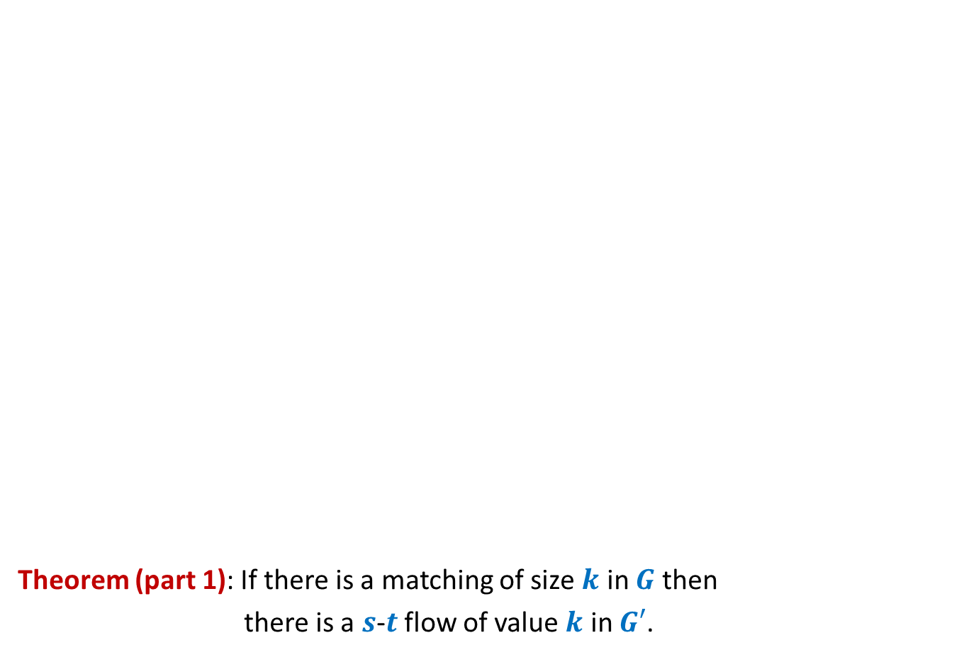
Bipartite matching Maximum Flow
?
Theorem (part 1): If there is a matching of size $k$ in $G$ then
there is a $s$-$t$ flow of value $k$ in $G′$.
applicants
jobs
$$1$$
$$1$$
$$1$$
$$1$$
$$1$$
$$1$$
$$1$$
$$1$$
$$G′$$
$$s$$
$$1$$
$$t$$
$$1$$
$$1$$
$$1$$
$$1$$
$$1$$
$$1$$
$$1$$
$$1$$
$$1$$
$$1$$
$$1$$
$$1$$
$$1$$
$$1$$

Slide 13
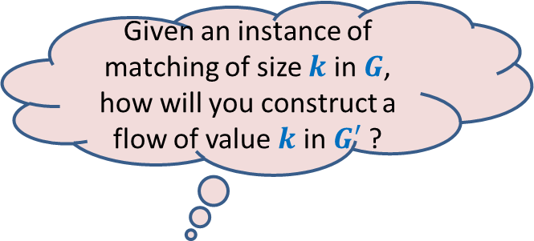

Bipartite matching Maximum Flow
?
Theorem (part 1): If there is a matching of size $k$ in $G$ then
there is a $s$-$t$ flow of value $k$ in $G′$.
Given an instance of matching of size $k$ in $G$, how will you construct a flow of value $k$ in $G′$ ?
applicants
jobs
$$1$$
$$1$$
$$1$$
$$1$$
$$1$$
$$1$$
$$1$$
$$1$$
$$G′$$
$$s$$
$$1$$
$$t$$
$$1$$
$$1$$
$$1$$
$$1$$
$$1$$
$$1$$
$$1$$
$$1$$
$$1$$
$$1$$
$$1$$
$$1$$
$$1$$
$$1$$
$$1$$

Slide 14
Bipartite matching Maximum Flow
?
Theorem (part 1): If there is a matching of size $k$ in $G$ then
there is a $s$-$t$ flow of value $k$ in $G′$.
applicants
jobs
$$1$$
$$1$$
$$1$$
$$1$$
$$1$$
$$1$$
$$1$$
$$1$$
$$G′$$
$$s$$
$$1$$
$$t$$
$$1$$
$$1$$
$$1$$
$$1$$
$$1$$
$$1$$
$$1$$
$$1$$
$$1$$
$$1$$
$$1$$
$$1$$
$$1$$
$$1$$
$$1$$

Slide 15
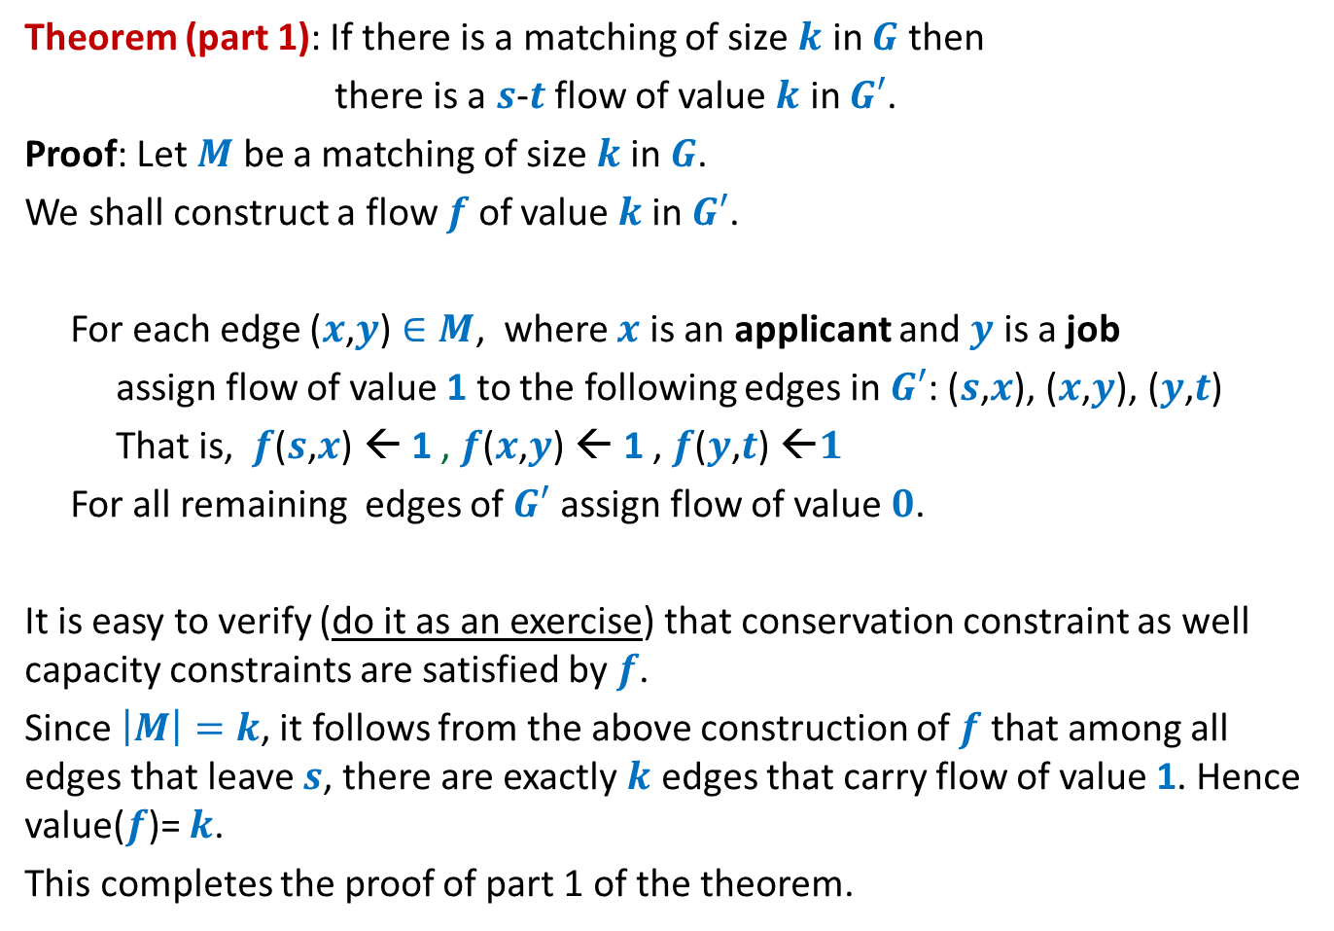
Theorem (part 1): If there is a matching of size $k$ in $G$ then
there is a $s$-$t$ flow of value $k$ in $G′$.
Proof: Let $M$ be a matching of size $k$in $G$.
We shall construct a flow $f$ of value $k$in $G′$.
For each edge ($x$,$y$) $∈M$, where $x$ is an applicant and $y$ is a job
assign flow of value 1 to the following edges in $G′$: ($s$,$x$), ($x$,$y$), ($y$,$t$)
That is, $f$($s$,$x$) ← 1 , $f$($x$,$y$) ← 1 , $f$($y$,$t$) ←$1$
For all remaining edges of $G′$ assign flow of value $0$.
It is easy to verify (do it as an exercise) that conservation constraint as well capacity constraints are satisfied by $f$.
Since $\left|M\right|=k$, it follows from the above construction of $f$that among all edges that leave $s$, there are exactly $k$ edges that carry flow of value 1. Hence value($f$)= $k$.
This completes the proof of part 1 of the theorem.

Slide 16


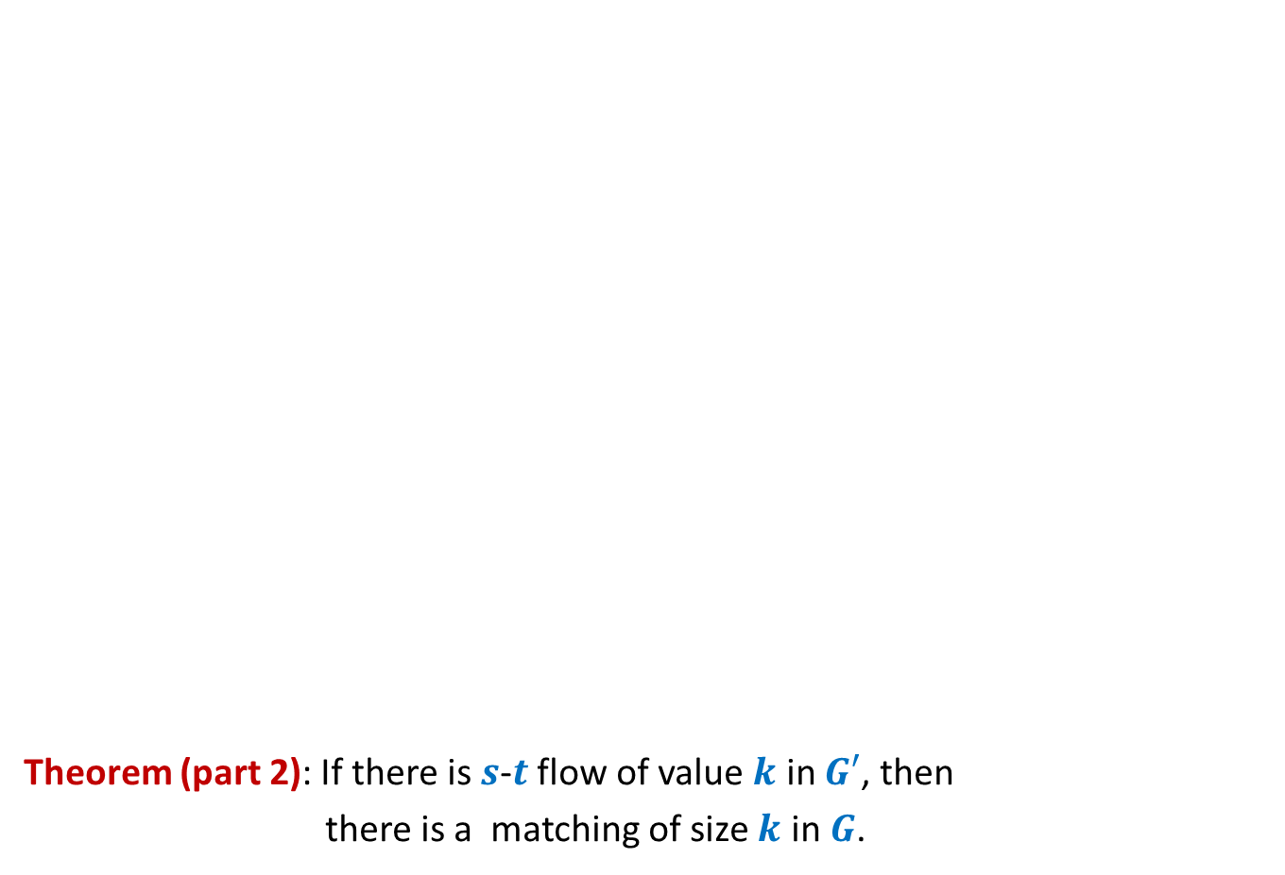
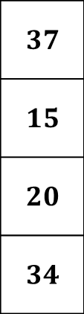


Bipartite matching Maximum Flow
Theorem (part 2): If there is $s$-$t$ flow of value $k$ in $G′$, then
there is a matching of size $k$ in $G$.
Given an instance of flow of value $k$ in $G′$, how will you construct a matching of size $k$ in $G$ ?
Integrality of flow
applicants
jobs
$$1$$
Unit edge capacity
$$1$$
$$1$$
$$1$$
$$1$$
$$1$$
$$1$$
$$A$$
$$1$$
$$G′$$
$$s$$
$$1$$
$$t$$
$$1$$
$$1$$
$$1$$
$$1$$
$A$= {$s$} $∪$ Applicants
$$1$$
$$1$$
$$1$$
$$1$$
$$1$$
$$1$$
$$1$$
$$1$$
Complete the proof with these pointer and verify with the proof given in the following slide.
$f_{out}\left(A\right)−f_{in}(A)$ = $k$
$$1$$
$$1$$
$$0$$
$$1$$

Slide 17
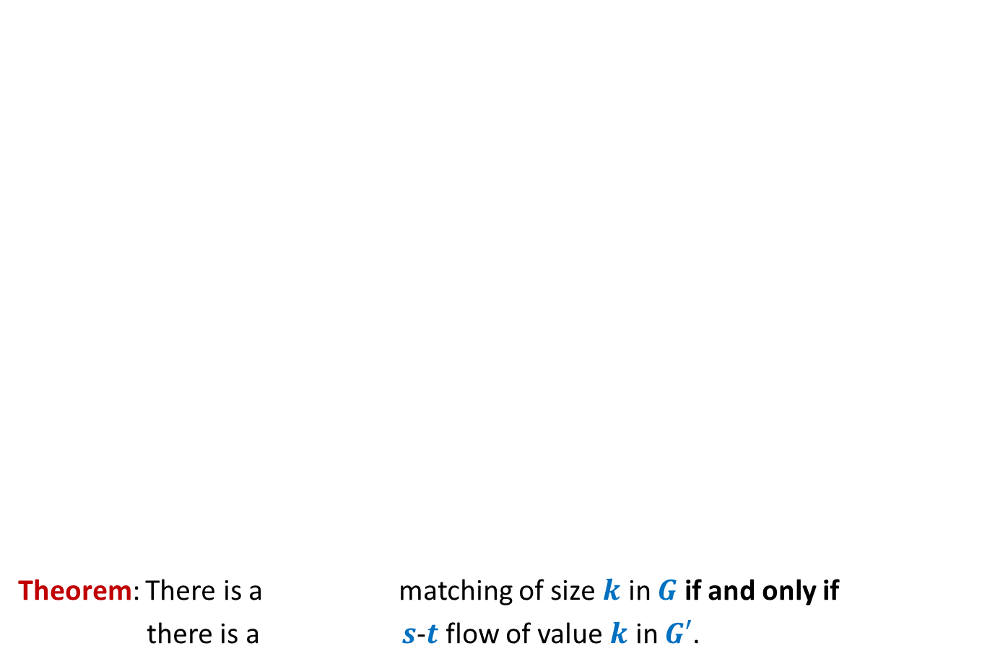
Theorem (part 2): If there is $s$-$t$ flow of value $k$ in $G′$, then
there is a matching of size $k$ in $G$.
Proof: Let $f$ be a $s$-$t$ flow of value $k$ in $G′$.
We shall now construct a matching of size $k$ in $G$.
Firstly, by integrality theorem, $f$ is integral.
Consider the set $A$= {$s$} $∪$ Applicants
So $f_{out}\left(A\right)−f_{in}(A)$ = $k$
Since there is no edge that enters $A$, so $f_{in}(A)$ = $0$,
Hence $f_{out}\left(A\right)$ = $k$.
Moreover, since capacity of each edge in $G′$ is $1$, each edge in $G′$ carries either no flow or a flow of value $1$.
Therefore, there are exactly $k$ edges between Applicants and jobs that carry flow of value $1$.
Let $M$ denote the set of these $k$ edges.
Since each edge leaving $s$ (and each edge entering $t$) has capacity $1$, there can be at most one edge from $M$incident on any applicant (or any job).
It thus follows that the set $M$is indeed a matching in $G$.
This completes the proof of part 2 of the theorem.

Slide 18

Application # 2 of Max-Flow
Maximum no. of Edge Disjoint paths from $s$ to $t$

Slide 19
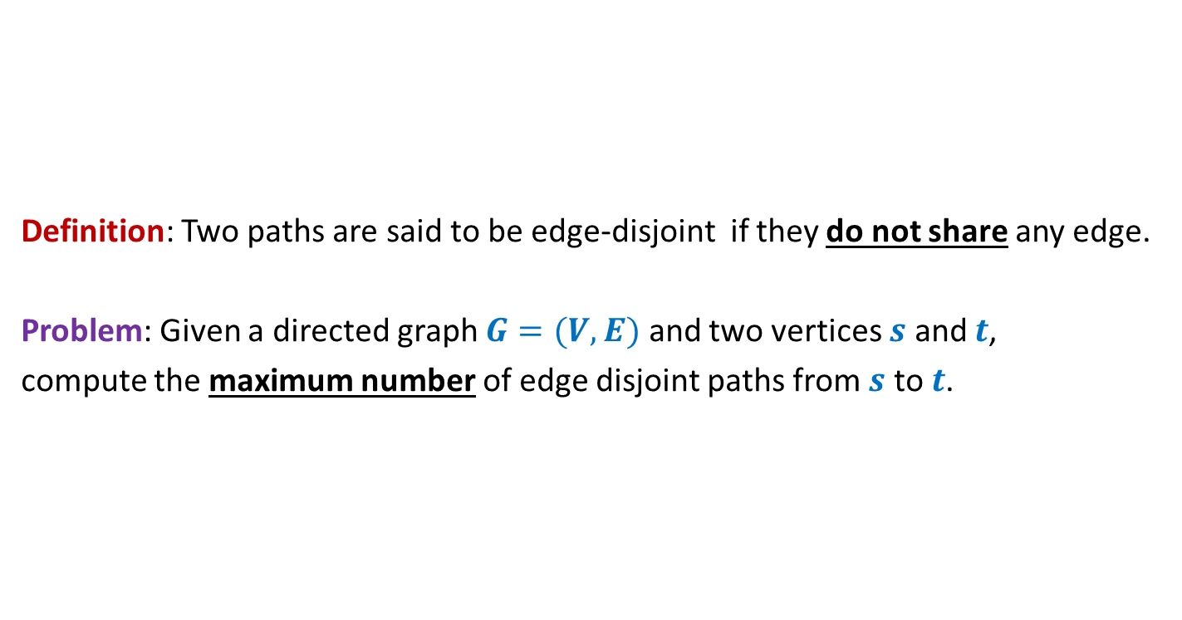

Maximum no. of Edge Disjoint paths from $s$ to $t$
Definition: Two paths are said to be edge-disjoint if they do not share any edge.
Problem: Given a directed graph $G=(V,E)$ and two vertices $s$ and $t$,
compute the maximum number of edge disjoint paths from $s$ to $t$.

Slide 20




Maximum no. of Edge Disjoint paths from $s$ to $t$
Intuition: View $G$ as a flow network, and compute max-flow from $s$ to $t$.
Question: What will be capacities of edges ?
Answer: unit capacity.
Question: What relationship exists between the two instances ?
A natural guess/intuition➔
maximum no. of $s$-$t$ paths in $G$ = max-flow from $s$ to $t$in the corresponding flow network.
$$G$$
$$s$$
$$t$$

Slide 21

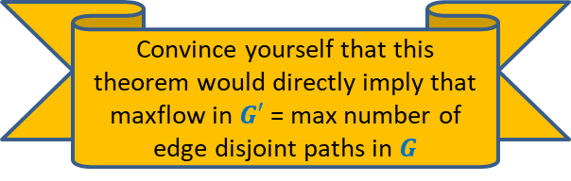
Maximum no. of Edge Disjoint paths from $s$ to $t$
Theorem:
There are $k$ edge disjoint paths from $s$ to $t$ in $G$
if and only if
there is a flow of value $k$ from $s$ to $t$in corresponding flow network
$$G$$
$$s$$
$$t$$
Convince yourself that this theorem would directly imply that
maxflow in $G′$ = max number of edge disjoint paths in $G$

Slide 22
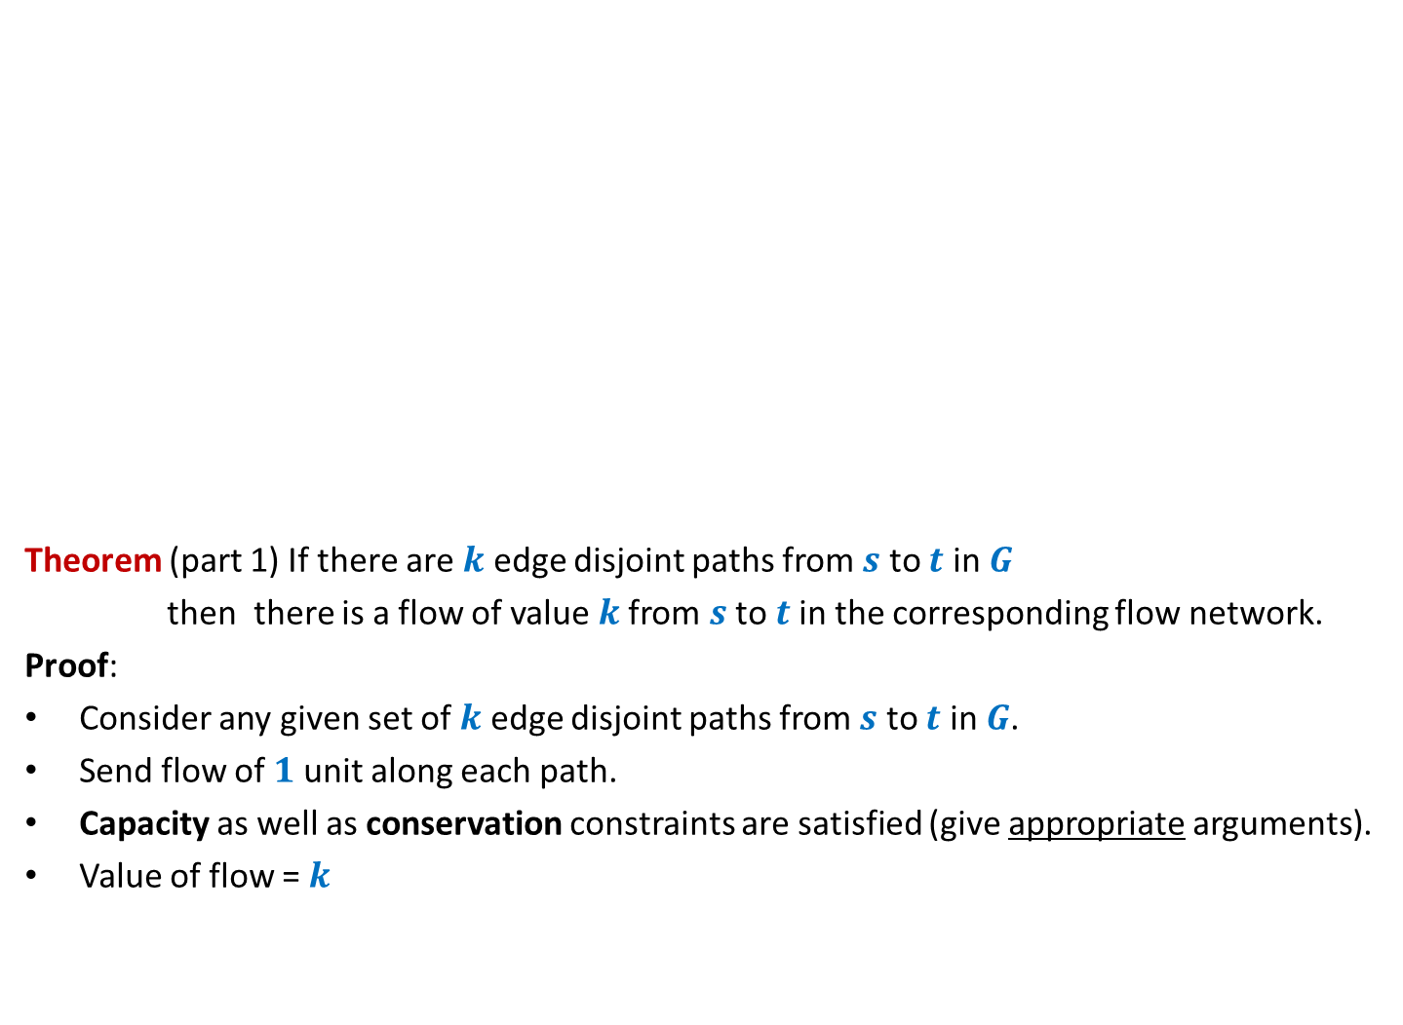
Maximum no. of Edge Disjoint paths from $s$ to $t$
Theorem (part 1) If there are $k$ edge disjoint paths from $s$ to $t$ in $G$
then there is a flow of value $k$from $s$ to $t$in the corresponding flow network.
Proof:
Consider any given set of $k$ edge disjoint paths from $s$ to $t$ in $G$.
Send flow of $1$ unit along each path.
Capacity as well as conservation constraints are satisfied (give appropriate arguments).
Value of flow = $k$
$$G$$
$$s$$
$$t$$

Slide 23

Maximum no. of Edge Disjoint paths from $s$ to $t$
Theorem (part 2) If there is a flow of value $k$from $s$ to $t$in the flow network
then there are $k$ edge disjoint paths from $s$ to $t$ in $G$.
Proof:
and
➔there exists a flow $f$ of value $k$such that $f \left(e\right)=1$or $0$for all $e∈E$.
Aim: To construct $k$ edge disjoint paths from $s$ to $t$ using edges carrying unit flow.
$$G$$
$$s$$
$$t$$
Integrality of flow
Unit edge capacity

Slide 24

Maximum no. of Edge Disjoint paths from $s$ to $t$
Theorem (part 2) If there is a flow of value $k$from $s$ to $t$in the flow network
then there are $k$ edge disjoint paths from $s$ to $t$ in $G$.
Proof: “Keep following any stream of flow originating from $s$ and terminating at $t$”.
What if we get caught in a loop ☹?
But is it possible in a flow ?
Yes, INDEED.
$$G$$
$$s$$
$$t$$

Slide 25

Maximum no. of Edge Disjoint paths from $s$ to $t$
Theorem (part 2) If there is a flow of value $k$from $s$ to $t$in the flow network
then there are $k$ edge disjoint paths from $s$ to $t$ in $G$.
$$G$$
$$s$$
$$t$$
Using the last animation as a hint,
make sincere attempts to prove this part of Theorem.
It is given on the following slide.

Slide 26
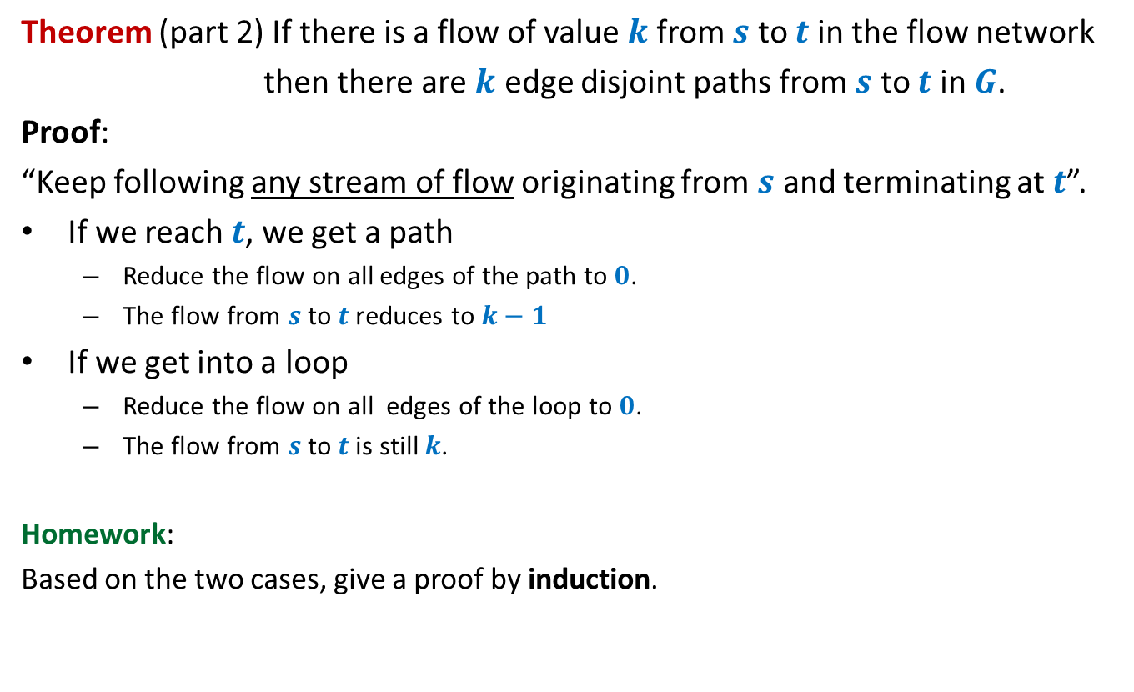
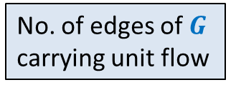


Maximum no. of Edge Disjoint paths from $s$ to $t$
Theorem (part 2) If there is a flow of value $k$from $s$ to $t$in the flow network
then there are $k$ edge disjoint paths from $s$ to $t$ in $G$.
Proof:
“Keep following any stream of flow originating from $s$ and terminating at $t$”.
If we reach $t$, we get a path
Reduce the flow on all edges of the path to $0$.
The flow from $s$ to $t$reduces to $k−1$
If we get into a loop
Reduce the flow on all edges of the loop to $0$.
The flow from $s$ to $t$is still $k$.
Homework:
Based on the two cases, give a proof by induction.
What will you induct on ?
No. of edges of $G$
$k$
No. of edges of $G$
carrying unit flow

Slide 27
Generalization of max-flow Problem
Extending the conservation constraint

Slide 28

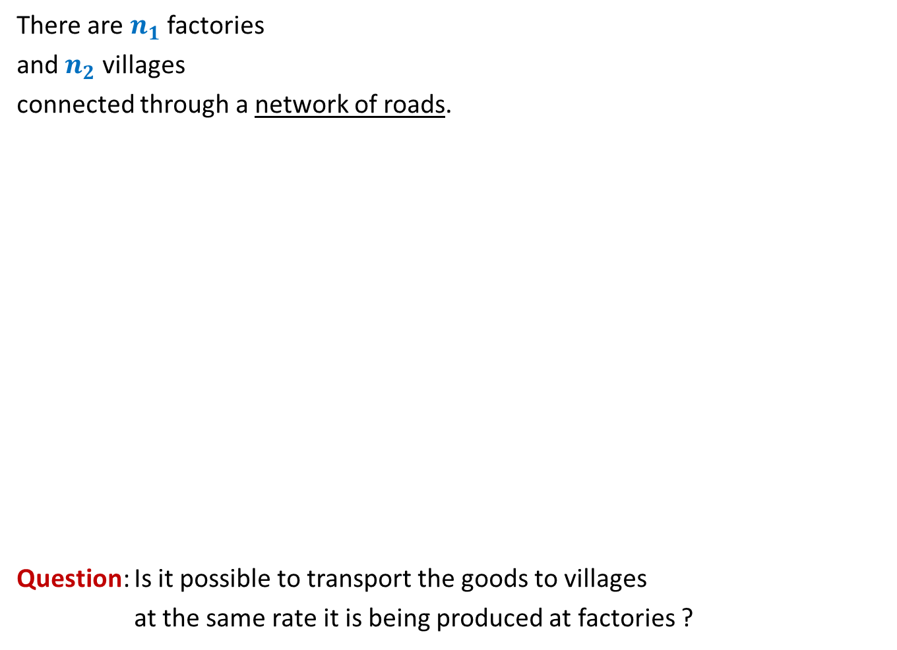
There are $n_{1}$ factories
and $n_{2}$ villages
connected through a network of roads.
Question: Is it possible to transport the goods to villages
at the same rate it is being produced at factories ?
600
400
300
No
Yes
What if roads have capacities ?
200
200
200
500

Slide 29
600
800
500
400
900
300
200
No
?
100
600
What if roads have capacities ?
200
700
200
700
300
50
200
500

Slide 30
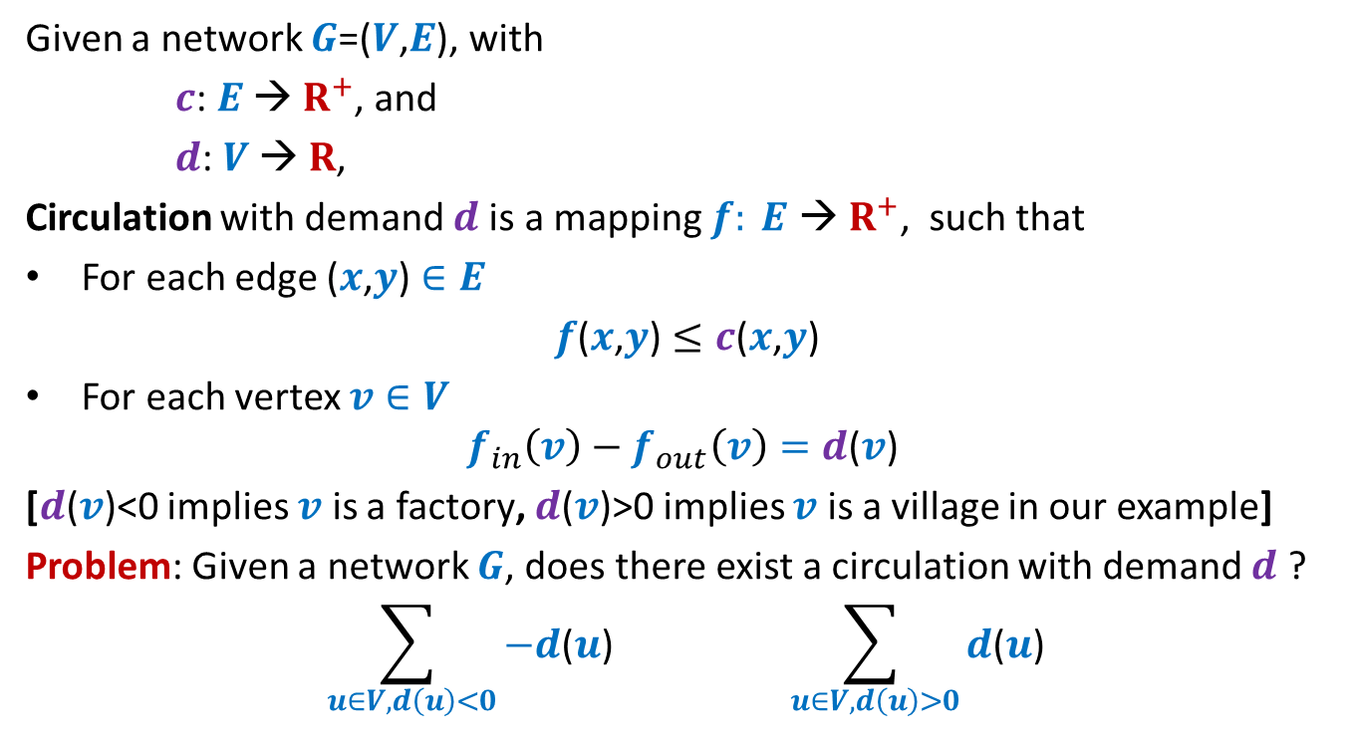
Circulation with demand
Given a network $G$=($V$,$E$), with
$c$: $E$ → $R^{+}$, and
$d$: $V$ → $R$,
Circulation with demand $d$is a mapping $f: E \text{→} R^{+}$, such that
For each edge ($x$,$y$) $∈E$
$f$($x$,$y$) $≤c$($x$,$y$)
For each vertex $v∈V$
$$f_{in}\left(v\right)−f_{out}\left(v\right)=d\text{(}v\text{)}$$
[$d\text{(}v\text{)<0}$ implies $v$ is a factory, $d\text{(}v\text{)>0}$ implies $v$ is a village in our example]
Problem: Given a network $G$, does there exist a circulation with demand $d$ ?
$$\sum_{ u∈V, d\left(u\right)<0}{−d\text{(}u\text{)}} \sum_{ u∈V, d\left(u\right)>0}{d\text{(}u\text{)}}$$
An absolutely necessary condition
$$D$$

Slide 31
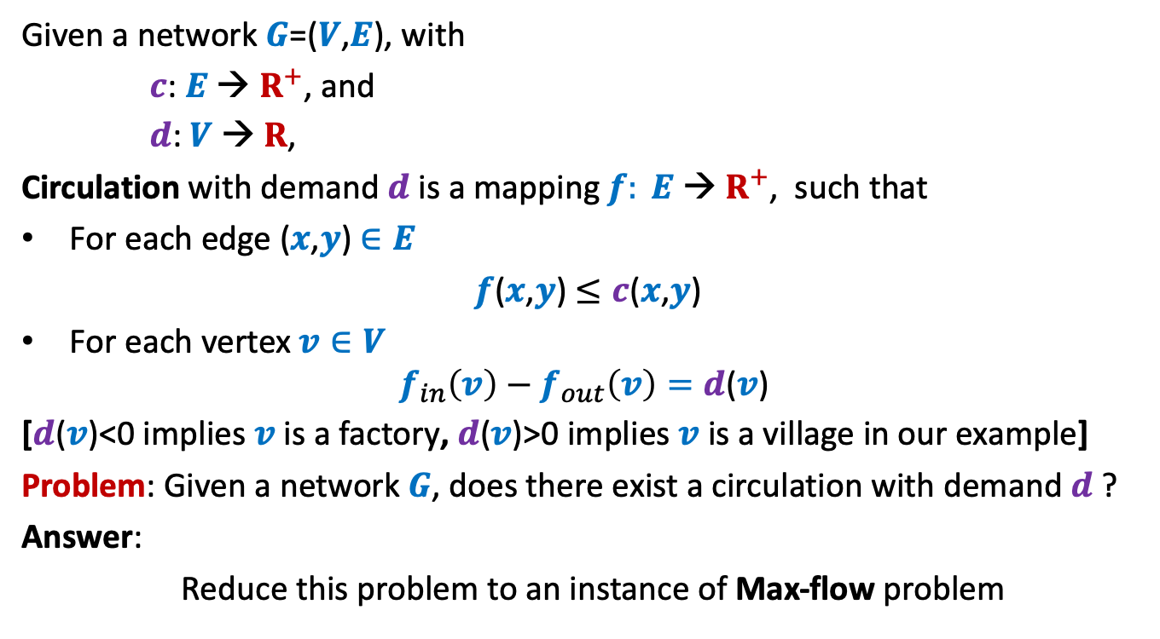
Circulation with demand
Given a network $G$=($V$,$E$), with
$c$: $E$ → $R^{+}$, and
$d$: $V$ → $R$,
Circulation with demand $d$is a mapping $f: E \text{→} R^{+}$, such that
For each edge ($x$,$y$) $∈E$
$f$($x$,$y$) $≤c$($x$,$y$)
For each vertex $v∈V$
$$f_{in}\left(v\right)−f_{out}\left(v\right)=d\text{(}v\text{)}$$
[$d\text{(}v\text{)}\text{<0}$ implies $v$ is a factory, $d\text{(}v\text{)}\text{>}\text{0}$ implies $v$ is a village in our example]
Problem: Given a network $G$, does there exist a circulation with demand $d$ ?
Answer:
Reduce this problem to an instance of Max-flow problem

Slide 32















Circulation with demand Max-Flow
?
Question: How does the corresponding instance of max-flow look like ?
Node with demand <0
Node with demand >0
$$v$$
$$−d(v)$$
$$a$$
$$d(a)$$
This is $G′$
This is $G$
$$s$$
$$b$$
$$d(b)$$
$$−d(w)$$
$$t$$
$$w$$
$$d(c)$$
$$−d(u)$$
$$c$$
$$u$$
$$x$$
$$d(x)$$

Slide 33
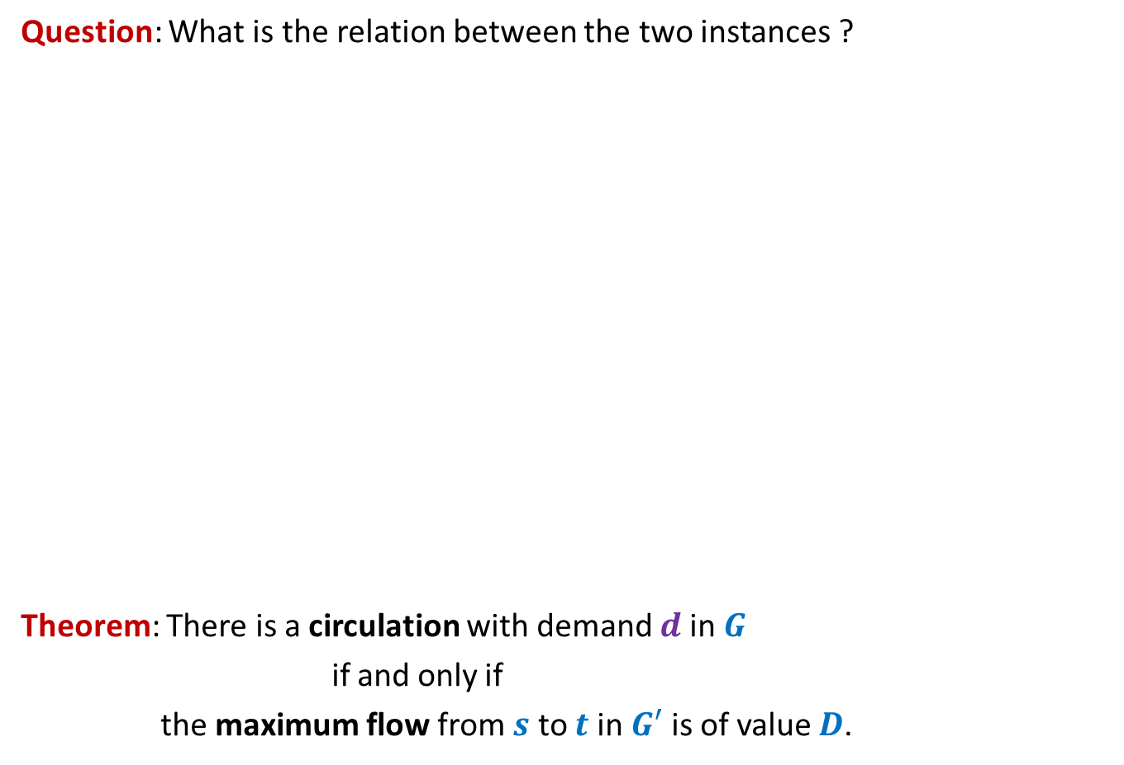
Circulation with demand Max-Flow
Question: What is the relation between the two instances ?
Theorem: There is a circulation with demand $d$in $G$
if and only if
the maximum flow from $s$ to $t$ in $G′$ is of value $D$.
Node with demand <0
Node with demand >0
$$v$$
$$−d(v)$$
$$a$$
$$d(a)$$
This is $G′$
$$s$$
$$b$$
$$d(b)$$
$$−d(w)$$
$$t$$
$$w$$
$$d(c)$$
$$−d(u)$$
$$c$$
$$u$$
$$x$$
How to prove it ?
Split it into 2 parts.
$$d(x)$$

Slide 34

Circulation with demand Max-Flow
Theorem (part 1): If there is a circulation with demand $d$in $G$,
then the maximum flow from $s$ to $t$ in $G′$ is of value $D$.
Node with demand <0
Node with demand >0
$$v$$
$$−d(v)$$
$$a$$
$$d(a)$$
This is $G′$
$$s$$
$$b$$
$$d(b)$$
$$−d(w)$$
$$t$$
$$w$$
$$d(c)$$
$$−d(u)$$
Complete the proof on your own and then verify with the proof given in the following slides.
$$c$$
$$u$$
$$x$$
$$d(x)$$

Slide 35
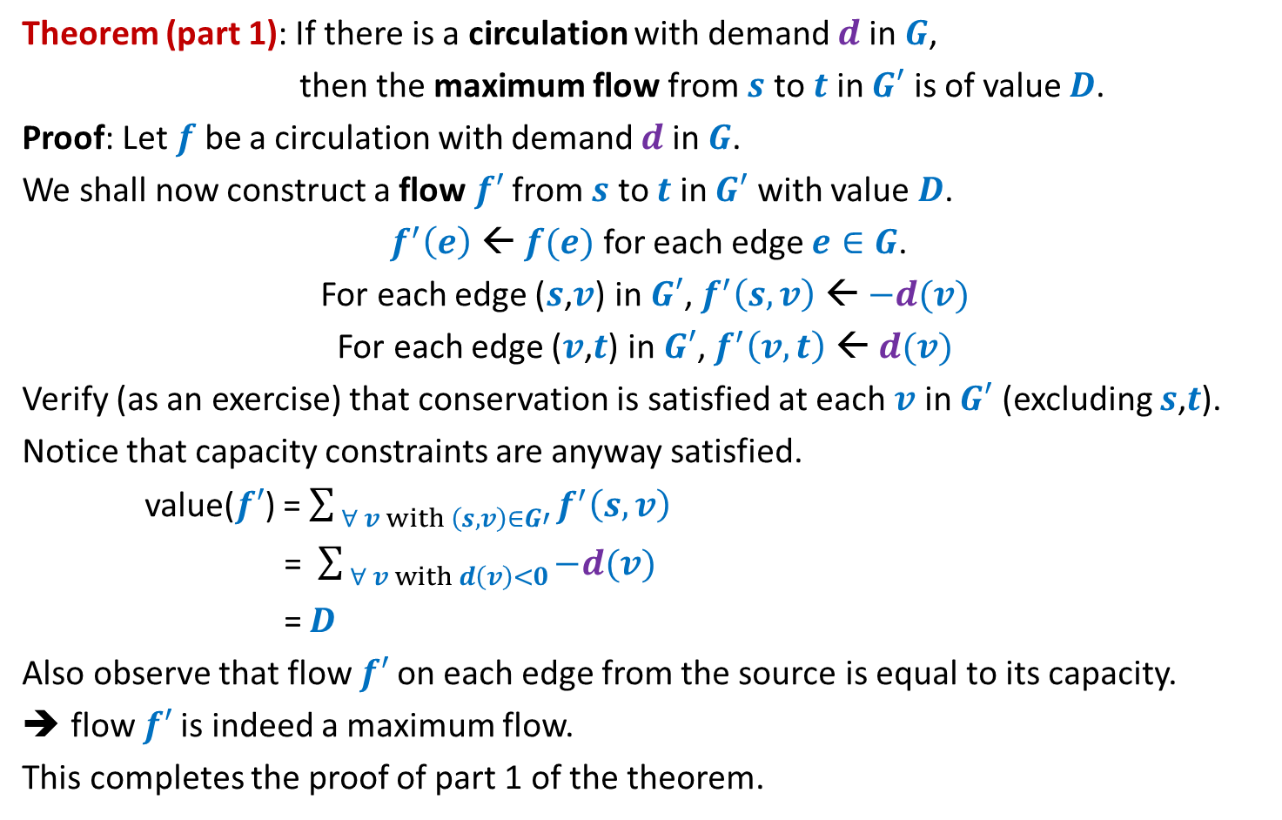
Theorem (part 1): If there is a circulation with demand $d$in $G$,
then the maximum flow from $s$ to $t$ in $G′$ is of value $D$.
Proof: Let $f$ be a circulation with demand $d$in $G$.
We shall now construct a flow $f′$from $s$ to $t$ in $G′$ with value $D$.
$f^{′}\left(e\right)$ ← $f(e)$ for each edge $e∈G$.
For each edge ($s$,$v$) in $G′$, $f^{′}\left(s,v\right)$ ← $−d(v)$
For each edge ($v$,$t$) in $G′$, $f^{′}\left(v,t\right)$ ← $d(v)$
Verify (as an exercise) that conservation is satisfied at each $v$ in $G′$ (excluding $s$,$t$).
Notice that capacity constraints are anyway satisfied.
value($f′$) = $\sum_{ ∀ v with \left(s,v\right)∈G′}{f^{′}\left(s,v\right)}$
= $\sum_{ ∀ v with d\left(v\right)<0}{−d(v) }$
= $D$
Also observe that flow $f′$on each edge from the source is equal to its capacity.
flow $f′$is indeed a maximum flow.
This completes the proof of part 1 of the theorem.

Slide 36


Circulation with demand Max-Flow
Theorem (part 2): If the maximum flow from $s$ to $t$ in $G′$ is of value $D$,
then there is a circulation with demand $d$in $G$.
Node with demand <0
Node with demand >0
$$−d(v)$$
$$v$$
$$−d(v)$$
$$a$$
$$d(a)$$
This is $G′$
$$s$$
$$b$$
$$d(b)$$
$$−d(w)$$
$$t$$
$$w$$
$$d(c)$$
$$−d(u)$$
$$c$$
$$u$$
$$x$$
$$d(x)$$

Slide 37
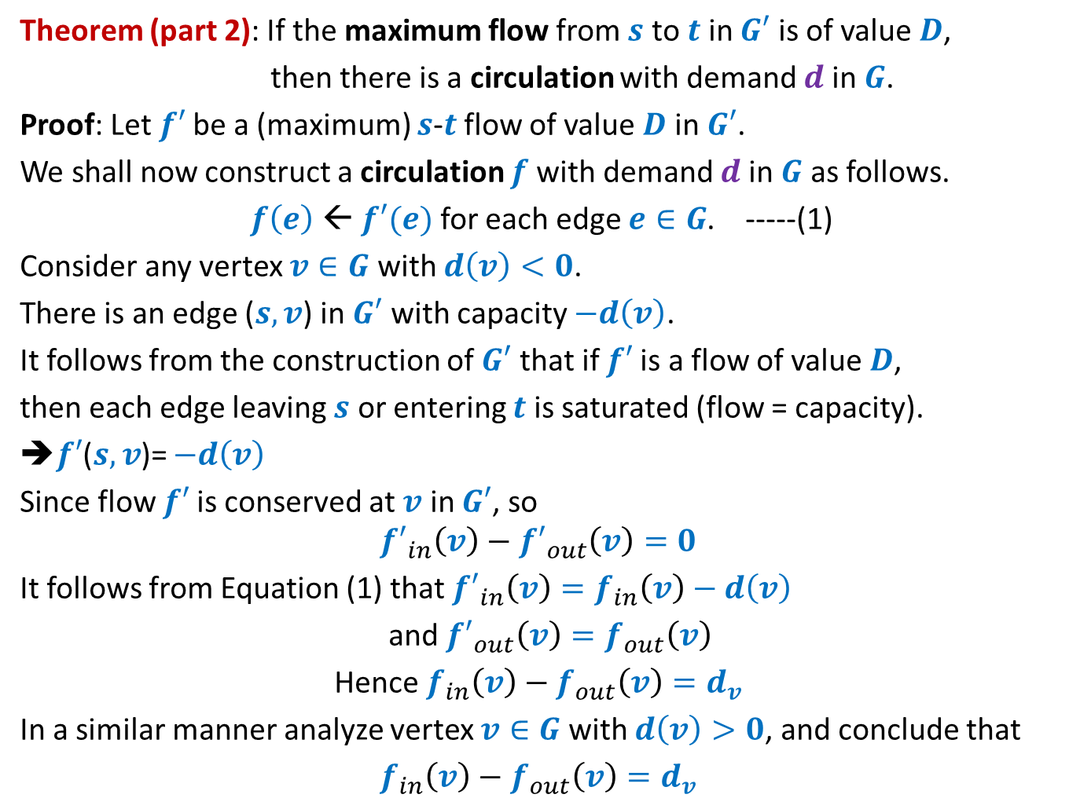
Theorem (part 2): If the maximum flow from $s$ to $t$ in $G′$ is of value $D$,
then there is a circulation with demand $d$in $G$.
Proof: Let $f′$be a (maximum) $s$-$t$ flow of value $D$ in $G′$.
We shall now construct a circulation $f$with demand $d$in $G$ as follows.
$f\left(e\right)$ ← $f′(e)$ for each edge $e∈G$. -----(1)
Consider any vertex $v∈G$ with $d\left(v\right)<0$.
There is an edge ($s,v$) in $G′$ with capacity $−d\left(v\right)$.
It follows from the construction of $G′$ that if $f′$is a flow of value $D$,
then each edge leaving $s$ or entering $t$ is saturated (flow = capacity).
➔$f′$($s,v$)= $−d\left(v\right)$
Since flow $f′$is conserved at $v$ in $G′$, so
$${f′}_{in}\left(v\right)−{f′}_{out}\left(v\right)=0$$
It follows from Equation (1) that ${f′}_{in}\left(v\right)=f_{in}\left(v\right)−d\left(v\right)$
and ${f′}_{out}\left(v\right)=f_{out}\left(v\right)$
Hence $f_{in}\left(v\right)−f_{out}\left(v\right)=d_{v}$
In a similar manner analyze vertex $v∈G$ with $d\left(v\right)>0$, and conclude that
$f_{in}\left(v\right)−f_{out}\left(v\right)=d_{v}$

